Slide 1

DEVELOPING a real-time multiplayer Noughts and crosses game using JFRAMES
TIC TAC TOE

Slide 2

TABLE OF CONTENTS
Introduction to Tic Tac Toe in Java
Designing the Game Board
Implementing the Game Logic
Adding Player and AI Options
Testing and Debugging
Conclusion

Slide 3

SOFTWARE REQUIREMENTS
Operating System : Windows XP Languages :JAVA Tools: J frames, java swing

Slide 4

HARDWARE REQUIREMENTS
PROCESSOR :INTEL PENTIUM RAM(SD/DDR):512MB HARD DISC :SSD

Slide 5
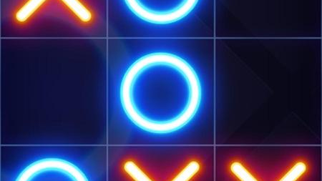

Introduction to Tic Tac Toe in Java
Tic Tac Toe is a classic game that has been played for generations. It's a simple game, but it can be surprisingly challenging to master.
In this presentation, we'll explore how to create a Tic Tac Toe game using Java programming language.
Java is a popular programming language that is widely used for developing applications and games.
It is known for its simplicity, reliability, and security. With Java, you can create robust and scalable applications that run on different platforms.

Slide 6
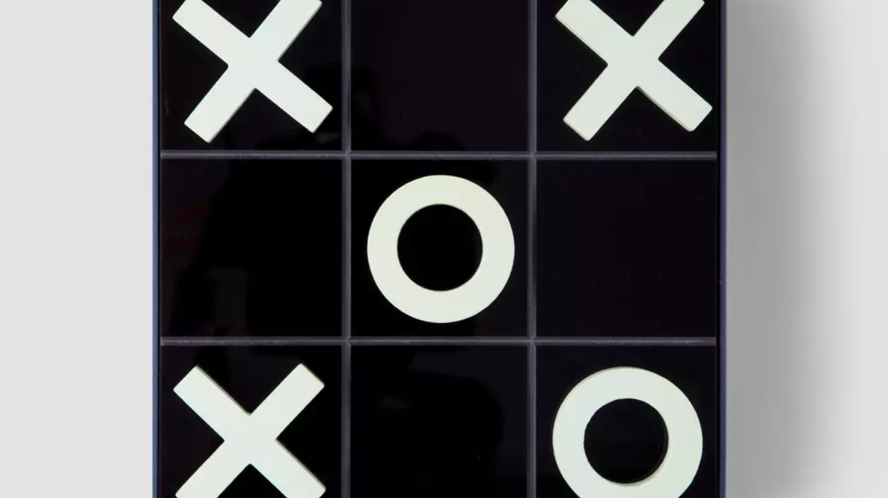
Designing the Game Board
The first step in creating a Tic Tac Toe game in Java is to design the game board.
The game board is a 3x3 grid that consists of nine squares. Each square can either be empty, marked with an X, or marked with an O.
To design the game board, we'll use Java's Swing library, which provides a set of GUI components for building user interfaces.
We'll create a JPanel object and add nine JButton objects to represent the squares on the game board.

Slide 7

Implementing the Game Logic
Once we have designed the game board, we need to implement the game logic.
The game logic determines how the game is played and how the winner is determined.
In Tic Tac Toe, the objective is to get three Xs or Os in a row, column, or diagonal.
To implement the game logic, we'll use Java's ActionListener interface, which allows us to handle user input events.
We'll write a method that checks if there is a winner after each move and updates the game board accordingly.

Slide 8
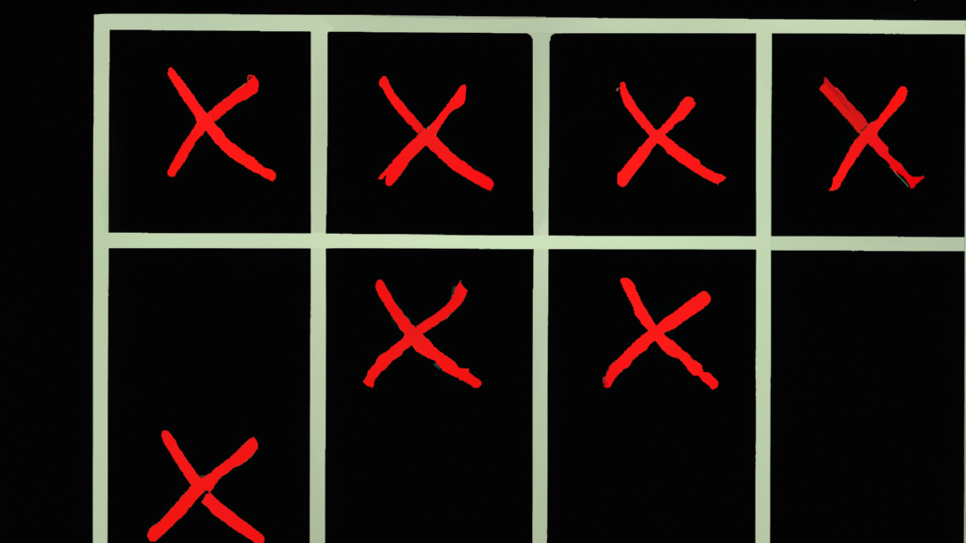
Adding Player AND AI Options
To make the game more interesting, we can add player and AI options.
In the player option, two players take turns marking the squares on the game board.
In the AI option, the player competes against a computer program that uses a set of rules to determine its moves.
To add the player and AI options, we'll create a menu bar that allows the user to select the desired option.
We'll also modify the game logic to accommodate the different gameplay modes.

Slide 9
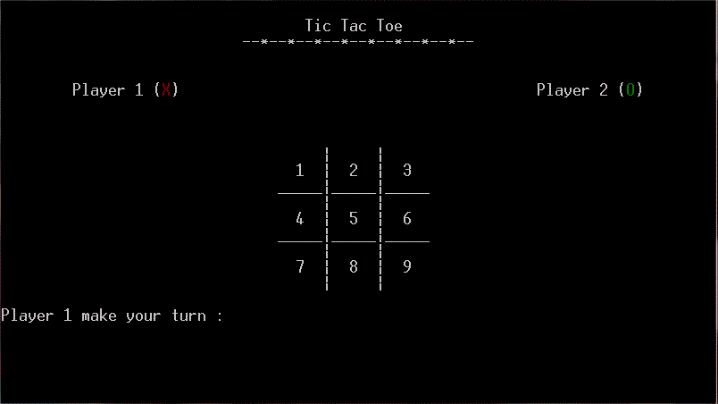
Testing and Debugging
After implementing the game logic and adding the player and AI options, we need to test and debug the game to ensure that it works correctly.
Testing involves playing the game and verifying that it behaves as expected.
Debugging involves identifying and fixing any errors or bugs in the code.
To test and debug the game, we'll use Java's debugging tools, such as breakpoints and watches.
We'll also solicit feedback from users and incorporate their suggestions into the game.

Slide 10

CONCLUSION
In conclusion, creating a Tic Tac Toe game in Java is a fun and challenging project that can help you improve your programming skills.
By following the steps outlined in this presentation, you can create a fully functional game that can be played by one or two players.
You can also customize the game by adding new features and options.
Java's versatility and flexibility make it an ideal programming language for developing games and applications.
Whether you're a beginner or an experienced programmer, Tic Tac Toe in Java is a great way to learn new skills and have fun at the same time

Slide 11

THANK YOU

